Slide 1
Introduction to Modern Controls
Modeling of Dynamic Systems
Modeling

Slide 2
Why modeling?
Modeling of physical systems:
a vital component of modern engineering
often consists of complex coupled differential equations
only when we have good understanding of a system can we optimally control it:
▶ can simulate and predict actual system response, and
▶ design model-based controllers
Modeling

Slide 3
Two general approaches of modeling
based on physics:
▶ using fundamental engineering principles such as Newton’s laws, energy conservation, etc
based on measurement data:
▶ using input-output response of the system
▶ a field itself known as system identification
Modeling

Slide 4
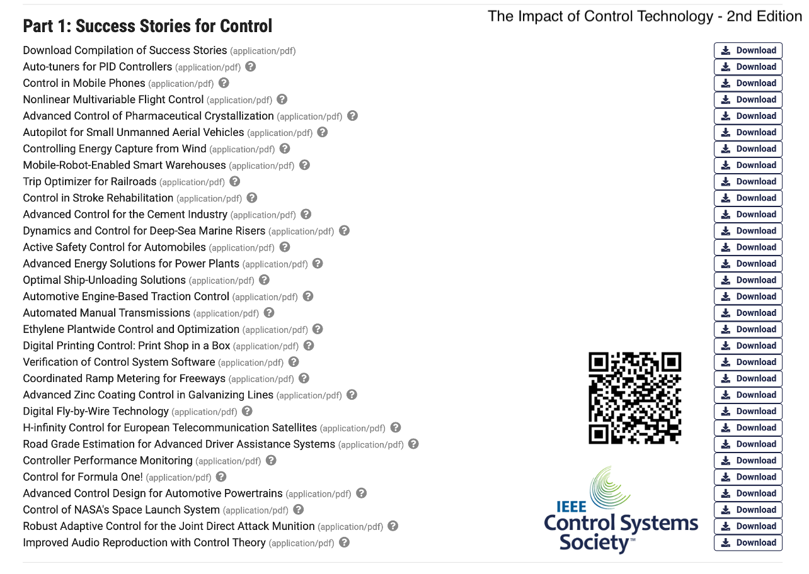
often the tools are combined in practice
Modeling

Slide 5
Example: Mass spring damper
position: y(t)
k
u = F
b
m
Newton’s second law gives
m¨y (t) + by˙ (t) + ky (t) = u (t) , y(0) = y₀, y˙(0) = y˙₀
modeled as a second-order ODE with input u(t) and output y(t)
Modeling

Slide 6
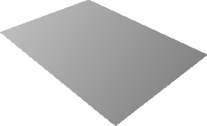








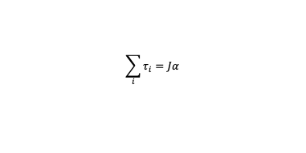
Example: HDD
Spindle
Head
Platter
Actuator Arm
Actuator Axis
Power Connector
Jumper Block
Actuator
IDE Connector
Newton’s second law for rotation
$$\text{net} \text{torque}\text{ =}$$
$$\text{moment} \text{of} \text{inertia} \text{x}$$
$$\text{angular} \text{acceleration}$$
$$\sum_{i}^{​}{τ_{i}}=Jα$$
letting θ :=output and τ :=input yields
θ¨ = α = ¹ τ
J
Modeling

Slide 7



Example: HDD
Spindle
Head
Platter
Actuator Arm
Actuator Axis
Power Connector
Jumper Block
Actuator
IDE Connector
θ¨ = α = ¹ τ ⇔ Θ(s) = ¹ T(s)
J Js²
with damping:
κ
s² + 2ζω_{n}s + ω_{n}²
θ¨ + 2ζω_{n}θ˙ + ω²θ = κτ ⇔ Θ(s) =
T(s)
n
with multiple modes:
θ¨_{i} + 2ζ_{i}ω_{i}θ˙_{i} + ω²θ_{i} = κ_{i}τ ⇔ Θ_{i}(s) = ^{κi} T(s)
i
s² + 2ζ_{i}ω_{i}s + ω²
i
Modeling

Slide 8
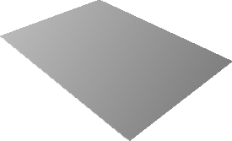




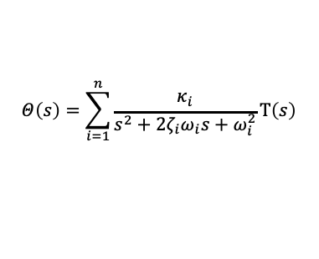
Example: HDD
Spindle
Head
Platter
Actuator Arm
Actuator Axis
Power Connector
Jumper Block
Actuator
IDE Connector
θ¨_{i} + 2ζ_{i}ω_{i}θ˙_{i} + ω²θ_{i} = κ_{i}τ ⇔ Θ_{i}(s) = ^{κi} T(s)
i
s² + 2ζ_{i}ω_{i}s + ω²
i
final model:
$$Θ\left(s\right)=\sum_{i=1}^{n}{\frac{κ_{i}}{s^{2}+2ζ_{i}ω_{i}s+ω_{i}^{2}}}T\left(s\right)$$
Modeling

Slide 9
import numpy as np
import matplotlib.pyplot as plt from scipy import signal import control as ct
num_sector = 420 # Number of sector num_rpm = 7200 # Number of RPM Kp_vcm = 3.7976e+07 # VCM gain
omega_vcm = np.array([0, 5300, 6100, 6500, 8050, 9600, 14800, 17400,
21000, 26000, 26600, 29000, 32200, 38300, 43300,
'→ 44800]) * 2 * np.pi
kappa_vcm = np.array([1, -1.0, +0.1, -0.1, 0.04, -0.7, -
0.2, -1.0, +3.0, -3.2, 2.1, -1.5, +2.0, -0.2,
'→ +0.3, -0.5])
zeta_vcm = np.array([0, 0.02, 0.04, 0.02, 0.01, 0.03, 0.01,
0.02, 0.02, 0.012, 0.007, 0.01, 0.03, 0.01, 0.01,
'→ 0.01])
Sys_Pc_vcm_c1 = ct.TransferFunction([], [1]) # Create an empty
'→ transfer function
for i in range(len(omega_vcm)):
Sys_Pc_vcm_c1 = Sys_Pc_vcm_c1 + ct.TransferFunction(np.array(
[0, 0, kappa_vcm[i]]) * Kp_vcm, np.array([1, 2 * zeta_vcm[i] *
'→ omega_vcm[i], (omega_vcm[i]) ** 2]))
Modeling

Slide 10
Pcv
100
50
0
50
Gain [dB]
10¹
10²
10³
10⁴
0
90
180
270
360
Phase [deg.]
10¹
10²
10³
Frequency [Hz]
10⁴
Modeling

Slide 11
Pcv
100
50
0
50
Gain [dB]
10¹
10²
10³
10⁴
0
90
180
270
360
Phase [deg.]
10¹
10²
10³
Frequency [Hz]
10⁴
Modeling

Slide 12
Pcv
100
50
0
50
Gain [dB]
10¹
10²
10³
10⁴
0
90
180
270
360
Phase [deg.]
10¹
10²
10³
Frequency [Hz]
10⁴
Modeling

Slide 13
Pcv
100
50
0
50
Gain [dB]
10¹
10²
10³
10⁴
0
90
180
270
360
Phase [deg.]
10¹
10²
10³
Frequency [Hz]
10⁴
Modeling

Slide 14
Pcv
100
50
0
50
Gain [dB]
10¹
10²
10³
10⁴
0
90
180
270
360
Phase [deg.]
10¹
10²
10³
Frequency [Hz]
10⁴
Modeling

Slide 15
Pcv
100
50
0
50
Gain [dB]
10¹
10²
10³
10⁴
0
90
180
270
360
Phase [deg.]
10¹
10²
10³
Frequency [Hz]
10⁴
Modeling

Slide 16
Pcv
100
50
0
50
Gain [dB]
10¹
10²
10³
10⁴
0
90
180
270
360
Phase [deg.]
10¹
10²
10³
Frequency [Hz]
10⁴
Modeling

Slide 17
Pcv
100
50
0
50
Gain [dB]
10¹
10²
10³
10⁴
0
90
180
270
360
Phase [deg.]
10¹
10²
10³
Frequency [Hz]
10⁴
Modeling

Slide 18
Pcv
100
50
0
50
Gain [dB]
10¹
10²
10³
10⁴
0
90
180
270
360
Phase [deg.]
10¹
10²
10³
Frequency [Hz]
10⁴
Modeling

Slide 19
Pcv
100
50
0
50
Gain [dB]
10¹
10²
10³
10⁴
0
90
180
270
360
Phase [deg.]
10¹
10²
10³
Frequency [Hz]
10⁴
Modeling

Slide 20
Pcv
100
50
0
50
Gain [dB]
10¹
10²
10³
10⁴
0
90
180
270
360
Phase [deg.]
10¹
10²
10³
Frequency [Hz]
10⁴
Modeling

Slide 21




Models of continuous-time systems
modeled as differential equations:
position: y(t)
k
u = F
b
m
m¨y (t) + by˙ (t) + ky (t) = u (t) , y(0) = y₀, y˙(0) = y˙₀
Spindle _{Head}
Platter
Actuator Arm
Actuator Axis
Power Connector
Jumper Block
Actuator
IDE Connector
θ¨_{i} + 2ζ_{i}ω_{i}θ˙_{i} + ω²θ_{i} = κ_{i}τ ⇔ Θ_{i}(s) = ^{κi} T(s)
i
s² + 2ζ_{i}ω_{i}s + ω²
i
Modeling

Slide 22

Models of continuous-time systems
General continuous-time systems:
$$\frac{d^{n}y\left(t\right)}{dt^{n}}+a_{n−1}\frac{d^{n−1}y\left(t\right)}{dt^{n−1}}+…+a_{0}y\left(t\right)=b_{m}\frac{d^{m}u\left(t\right)}{dt^{m}}+b_{m−1}\frac{d^{m−1}u\left(t\right)}{dt^{m−1}}+…+b_{0}u\left(t\right)$$
with the initial conditions y(0
(n)
(n)
) = y , . . . , y (0) = y .
0
0
Modeling

Slide 23
Models of discrete-time systems
General discrete-time systems
inputs and outputs defined at discrete time instances k = 1, 2, . . .
described by ordinary difference equations in the form of
y(k)+a_{n−1}y(k−1)+· · ·+a₀y(k−n) = b_{m}u(k+m−n)+· · ·+b₀u(k−n)
Example: bank statements
x(k + 1) = (1 + ρ)x(k) + u(k), x(0) = x₀
k – month counter; ρ – interest rate; x(k) – wealth at the beginning of month k; u(k) – money saved at the end of month k; x₀ – initial wealth in account
Modeling

Slide 24
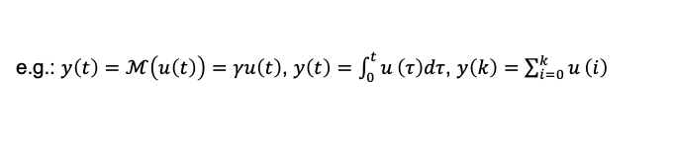
Model properties: static v.s. dynamic, causal v.s. acausal
u
M
_{y}
Model M is said to be
memoryless or static if y(t) depends only on u(t)
dynamic (has memory) if y at time t depends on input values at other times
e.g.: $y\left(t\right)=ℳ\left(u\left(t\right)\right)=γu\left(t\right)$, $y\left(t\right)=\int_{0}^{t}{u}\left(τ\right)dτ$, $y\left(k\right)=\sum_{i=0}^{k}{u}\left(i\right)$
causal if y(t) depends on u(τ ) for τ ≤ t
strictly causal if y(t) depends on u(τ ) for τ < t, e.g.: y(t) = u(t − 10)
Modeling

Slide 25
Linearity and time-invariance
The system M is called
linear if satisfying the superposition property:
M(α₁u₁(t) + α₂u₂(t)) = α₁M(u₁(t)) + α₂M(u₂(t))
for any input signals u₁(t) and u₂(t), and any real numbers α₁ and α₂ time-invariant if its properties do not change with respect to time e.g., y˙(t) = Ay(t) + Bu(t) is linear and time-invariant
y˙(t) = 2y(t) − sin(y(t))u(t) is nonlinear, yet time-invariant
y˙(t) = 2y(t) − t sin(y(t))u(t) is time-varying
assuming the same initial conditions, if we shift u(t) by a constant time interval, i.e., consider M(u(t + τ₀)), then M is time-invariant if the output M(u(t + τ₀)) = y(t + τ₀)
Modeling

Slide 26
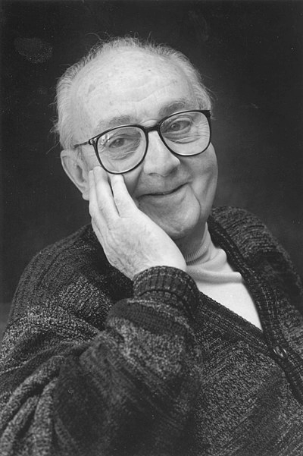
George Box
“All Models are Wrong, but Some are Useful”
statistical models always fall short of the complexities of reality but can still be useful nonetheless
a dynamic system may simply be too complex (consider the neural system of human brains)
or there are inevitable hardware uncertainties such as the fatigue of gears or bearings in a car
Modeling

Slide 27
Example (HDDs under perturbation)
^{P}cv
0
-20
-40
Gain [dB]
temperature influence manufacturing variations but, control works!
-60
-80
10³
10⁴
Frequency [Hz]
0
Phase [deg.]
-90
-180
-270
-360
10³
10⁴
Frequency [Hz]
Modeling

Slide 28
Example (HDDs under perturbation)
^{P}cv
Amplitude spectrum of y_{c}
0
-60
Gain [dB]
-20
-80
-40
-100
-60
Amplitude [dB]
-120
-80
Case 1
Case 2
Case 3
Case 4
Case 5
Case 6
Case 7
Case 8
Case 9
10³
10⁴
Frequency [Hz]
-140
-160
0
-180
Phase [deg.]
-90
-200
-180
10¹
10² 10³
Frequency [Hz]
10⁴
-270
-360
10⁴
Frequency [Hz]
10³
Modeling

Slide 29
Example (HDDs under perturbation)
^{P}cv
y_{c}
0
15
Gain [dB]
-20
10
-40
Amplitude [% of Track width]
5
-60
-80
0
Case 1
Case 2
Case 3
Case 4
Case 5
Case 6
Case 7
Case 8
Case 9
10³
10⁴
Frequency [Hz]
-5
0
-10
-90
Phase [deg.]
-15
0 200
400
600
800
1000
-180
Time [ms]
-270
-360
10⁴
Frequency [Hz]
10³
Modeling

Slide 30
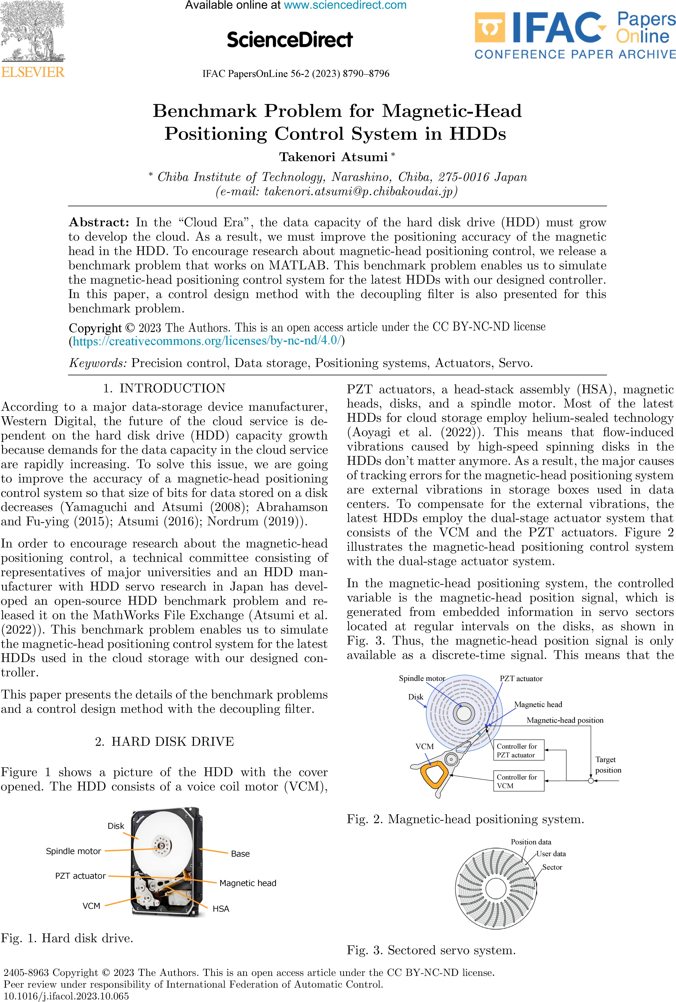
Example (HDDs under perturbation)
^{P}cv
0
-20
-40
-60
-80
Gain [dB]
10³
10⁴
Frequency [Hz]
0
-90
-180
-270
-360
Phase [deg.]
10³
10⁴
Frequency [Hz]
Modeling

